Slide 1

Loan Approval Likelihood
Team Members: Desiree Diaz, Medina Izgutdina, Irene Okada, Wei Zhu

Slide 2
Hypothesis:
Married men with a graduate degree are more likely to qualify for the highest loan amount
Data source:
Loan Prediction Problem Dataset | Kaggle
Inputs:
Credit history, Loan amount, Loan term, Applicant salary, Co-applicant salary, Resident location type (Rural, Urban, Suburban), Number of Dependents, Marriage status, Graduate status, Employment status, Approval status

Slide 3
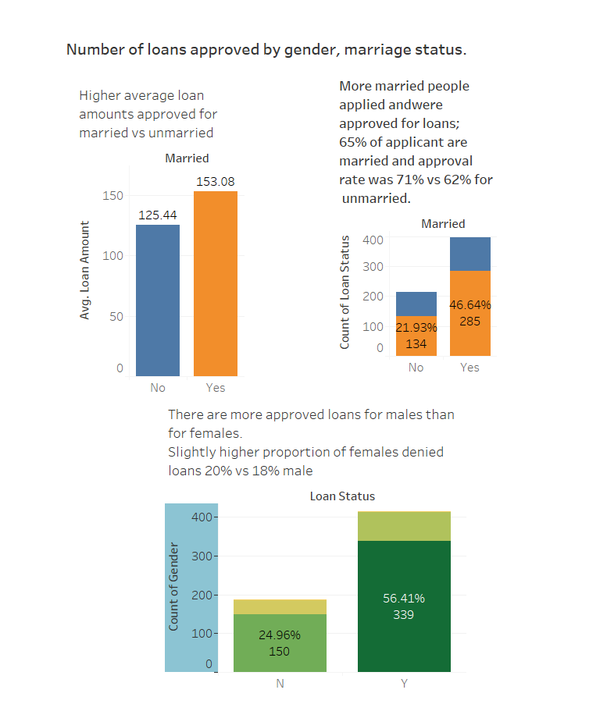
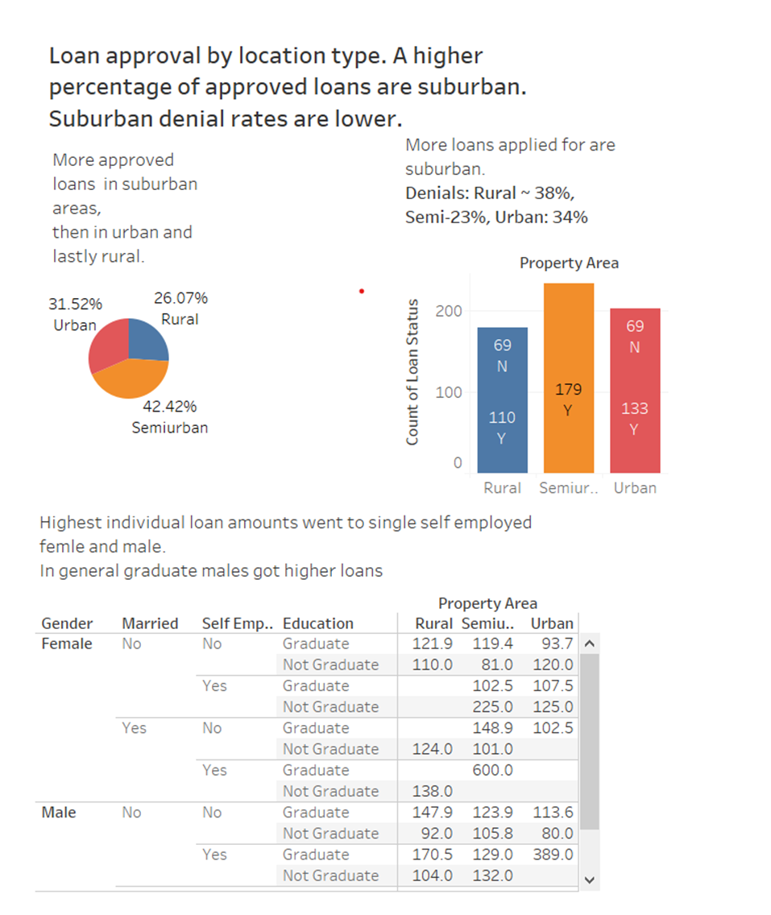
Data Overview

Slide 4
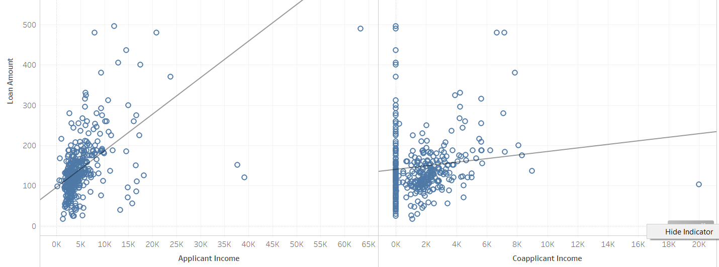
Income vs Loan amount: 2 incomes more consistent with higher loan

Slide 5
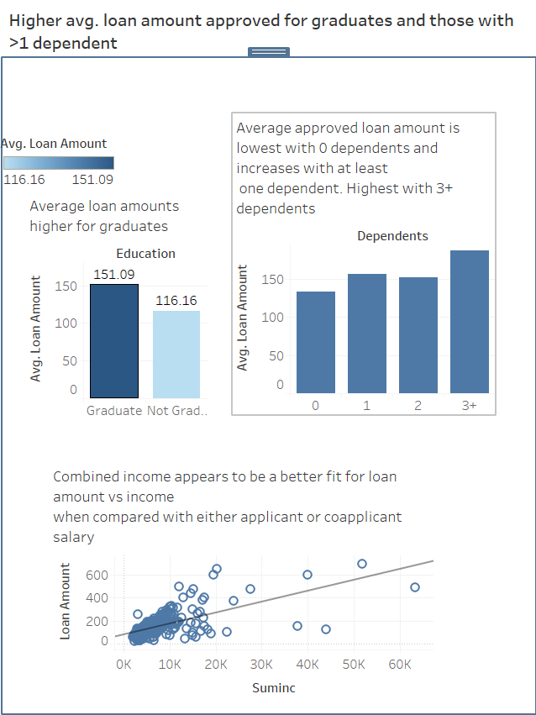
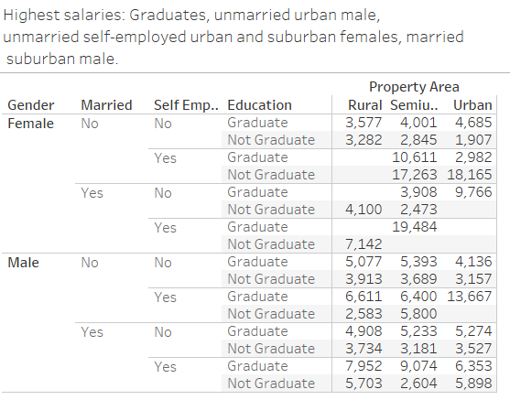
https://public.tableau.com/profile/ireneokada

Slide 6
Descriptive Summary
Overall: approval rates were higher for men, those who are married, suburbanites, graduates and those with a co-applicant
Overall: average loan amounts seem higher for graduates, those with a co-applicant and those with >1 dependent

Slide 7
Explanatory model
Dependent variable (y): Loan Approval (Y/N)
Independent/predictor variables (X):
Credit history
Loan amount
Loan term
Applicant salary
Co-applicant salary
Resident location type (Rural, Urban, Suburban)
Number of Dependents
Marriage status
Graduate or not
Self-employed or not

Slide 8
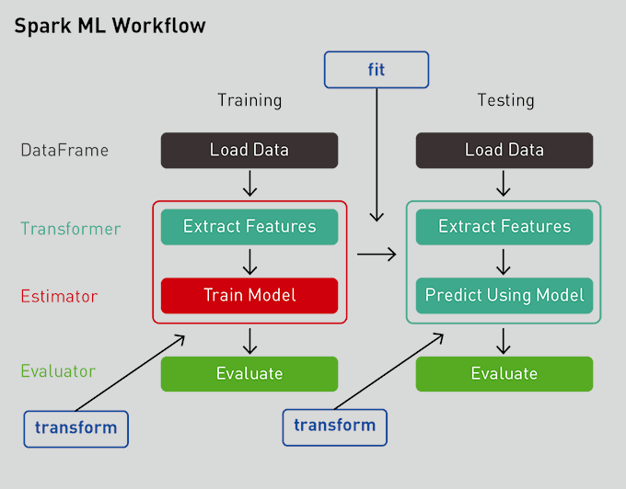
Model: Gradient Boosting Classifier with Pipeline ML workflow
•Model Used: Gradient Boosting Classifier •We used pipeline from sklearn library to optimize the coding process and standardize workflow •This helped with pre-processing of our data and transforming of categorical data •Pipeline enables a sequence of data to be transformed and correlated in a model that can be tested and evaluated to achieve an outcome, this improves ”fit” •Created ML model was trained on the existing dataset •The learning algorithm finds patterns in training data that maps input data to the target (or outcome to be predicted) •Accuracy of this model was ~ .85

Slide 9
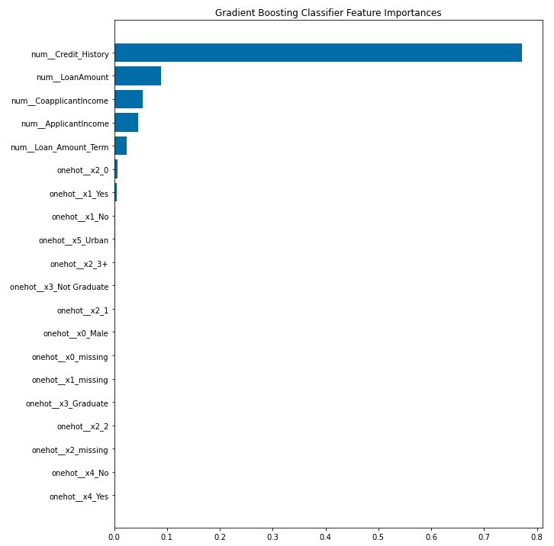
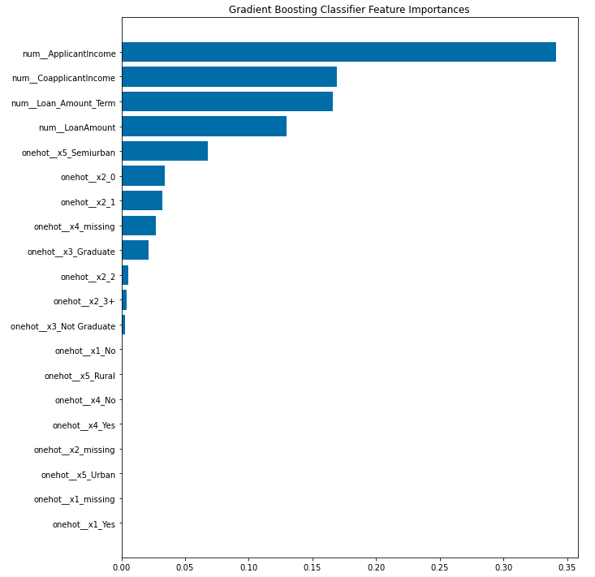
Featured factors in loan approval are Credit History, Loan Amount, Applicant and Co-applicant Income. When Credit History is removed importance expands to Suburban location and those with 2-3 Dependents
✱
Notes:
One-Hot Encoded:
0 Gender (Male/Female)
1 Married (Y/N)
2 Dependents (0, 1, 2, 3+)
3 Education (Graduate/Not Graduate)
4 Self-Employed (Y/N)
5 Property type (Urban, Semiurban, Rural)

Slide 10
Conclusion
The statistical model appears to agree with descriptive data, allowing us to predict loan approval with an accuracy of .85
Our hypothesis appears not to be proven; neither gender nor property location type appear in the top predictive variables.

Slide 11
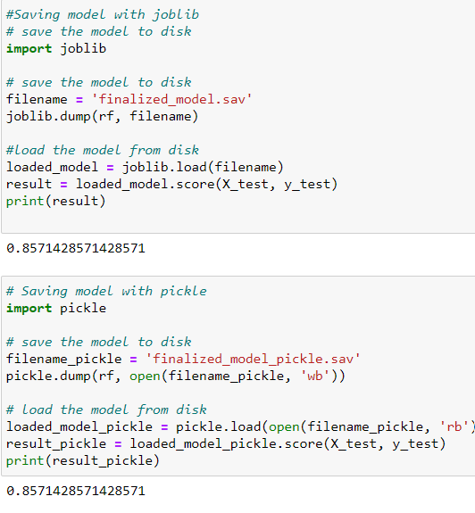
The model has an accuracy of .85

Slide 12
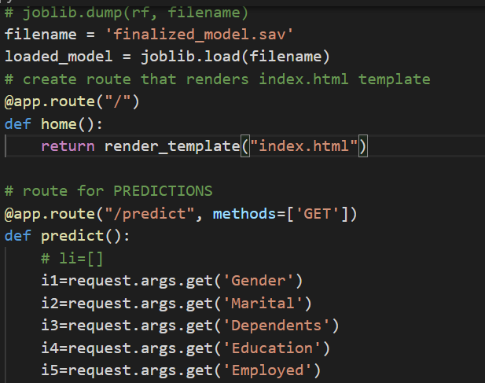
Model saved and loaded into app
Based on the model, Loan Application was designed

Slide 13
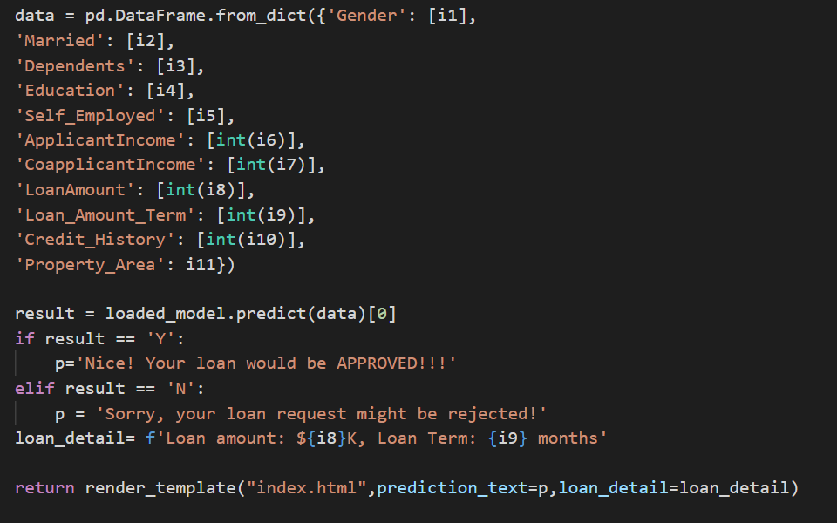
Inputs from model used to code loan application app

Slide 14
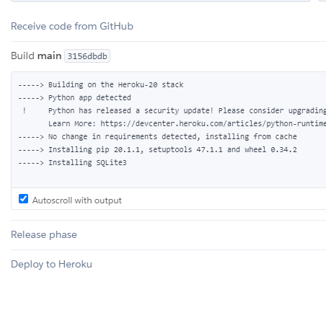
Installing the application libraries from GitHub to Heroku

Slide 15
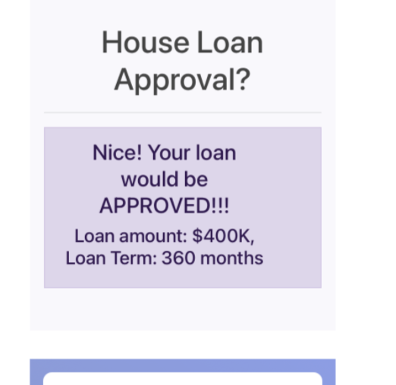
Demonstration: App hosted on Heroku
https://loan-predictions.herokuapp.com/

